Slide 1
Introduction to Programming
Spring 2022
Notes:
2/13/2022

Slide 2
Sequences: Strings, Lists, and Files
The String Data Type
Simple String Processing
List as Sequences
String Representation and Message Encoding
String Methods
Lists Have Methods too
From Encoding to Encryption
Input/Output as String Manipulation
File Processing
CSCI 1410
Dr. Salim Lakhani
/
Notes:
2/13/2022

Slide 3
Input/Output as String Manipulation
Often we will need to do some string operations to prepare our string data for output (“pretty it up”)
Let’s say we want to enter a date in the format “05/24/2015” and output “May 24, 2015.” How could we do that?
CSCI 1410
Dr. Salim Lakhani
/
Notes:
2/13/2022

Slide 4
Input/Output as String Manipulation
Algorithm to format a date:
Python Code
Split into month, day, and year
Convert month string into a number
Using eval to convert month string into a number
We can use the int function to convert month string into a number
CSCI 1410
Dr. Salim Lakhani
/
Notes:
2/13/2022
dateStr = input("Enter a date (mm/dd/yyyy): ")
monthStr, dayStr, yearStr = dateStr.split("/")
We cannot use eval if month string is 05 for example.
Use month number to lookup month name
Now let’s concatenate the output string together!

Slide 5
Input/Output as String Manipulation
Sometimes we want to convert a number into a string.
We can use the str function.
CSCI 1410
Dr. Salim Lakhani
/
Notes:
2/13/2022
>>> str(500)
'500'
>>> value = 3.14
>>> str(value)
'3.14'
>>> print("The value is", str(value) + ".")
The value is 3.14.

Slide 6
Input/Output as String Manipulation
We now have a complete set of type conversion operations:
Function | Meaning
float(<expr>) | Convert expr to a floating point value
int(<expr>) | Convert expr to an integer value
str(<expr>) | Return a string representation of expr
eval(<string>) | Evaluate string as an expression
CSCI 1410
Dr. Salim Lakhani
/
Notes:
2/13/2022
>>> ord("A")
65
>>> ord("a")
97
>>> chr(97)
'a'
>>> chr(65)
'A'
>>> chr(193)
'Á'
>>> chr(169)
©

Slide 7
String Formatting
String formatting is an easy way to get beautiful output!
Example – Change Counter
<template-string>.format(<values>)
{} within the template-string mark “slots” into which the values are inserted.
Each slot has description that includes format specifier telling Python how the value for the slot should appear.
CSCI 1410
Dr. Salim Lakhani
/
Notes:
2/13/2022

Slide 8
String Formatting
Form of description:
<index>:<format-specifier>
Index tells which parameter to insert into the slot.
The formatting specifier has the form: <width>.<precision><type>
f means "fixed point" number
<width> tells us how many spaces to use to display the value. 0 means to use as much space as necessary.
<precision> is the number of decimal places.
CSCI 1410
Dr. Salim Lakhani
/
Notes:
2/13/2022
>>> "Hello {0} {1}, you may have won ${2}" .format("Mr.", "Smith", 10000)
>>> 'This int, {0:5}, was placed in a field of width 5'.format(7)
>>> 'This int, {0:10}, was placed in a field of witdh 10'.format(10)
>>> 'This float, {0:10.5}, has width 10 and precision 5.'.format(3.1415926)
>>> 'This float, {0:10.5f}, is fixed at 5 decimal places.'.format(3.1415926)
>>> "Compare {0} and {0:0.20}".format(3.14)
'Compare 3.14 and 3.1400000000000001243'
txt = "For only {price:.2f} dollars!"
print(txt.format(price = 49))

Slide 9
String Formatting
Numeric values are right-justified and strings are left- justified, by default.
You can also specify a justification before the width.
CSCI 1410
Dr. Salim Lakhani
/
Notes:
2/13/2022
>>> "left justification: {0:<5}.format("Hi!")
'left justification: Hi! '
>>> "right justification: {0:>5}.format("Hi!")
'right justification: Hi!'
>>> "centered: {0:^5}".format("Hi!")
'centered: Hi! '

Slide 10
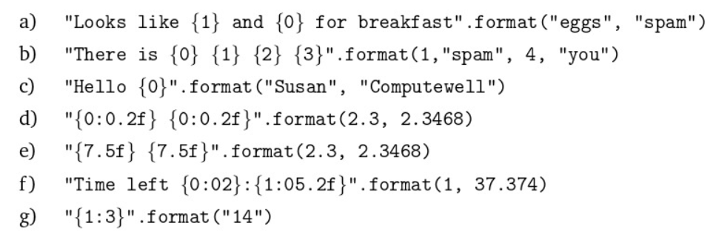
Class Work
Show the string that would result from each of the following formatting operations:
CSCI 1410
Dr. Salim Lakhani
/
Notes:
2/13/2022

Slide 11
Class Work
Download the file futval.py from Canvas. This program prompts the user for the amount of the investment, the annualized interest rate, and the number of years of investment.
Run the program.
Fix the print statements so that output is nicely formatted in the form of a table.
CSCI 1410
Dr. Salim Lakhani
/
Notes:
2/13/2022

